Slide 1


Meetup
PowerShell

Slide 2
Create Lab Tenant

Slide 3
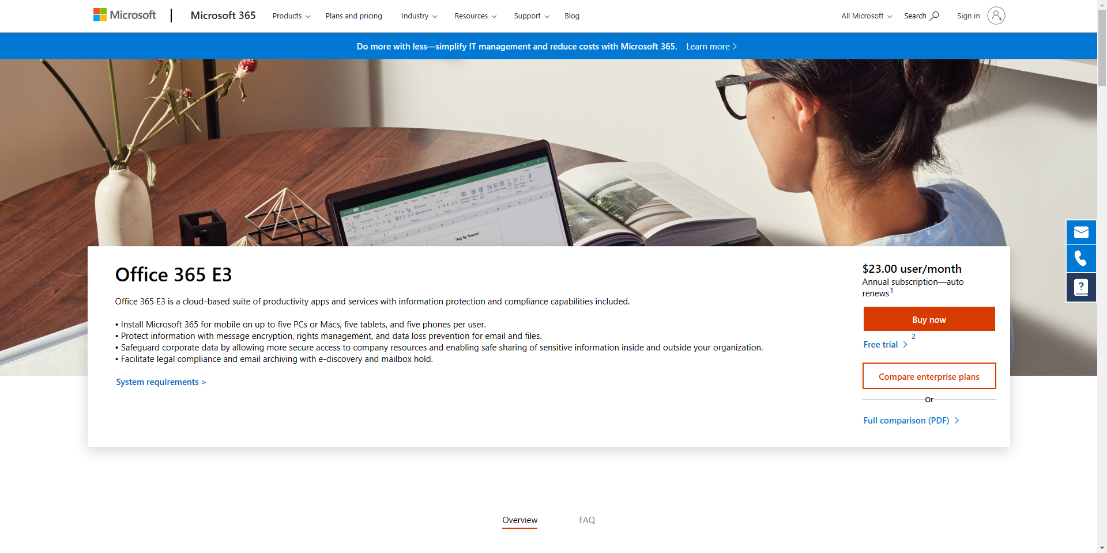
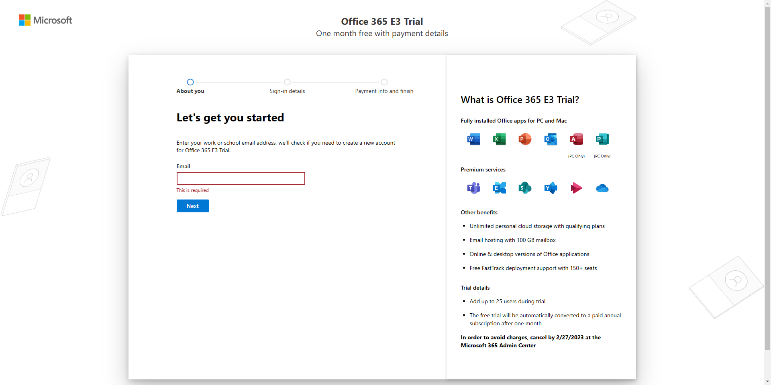
Create Tenant

Slide 4
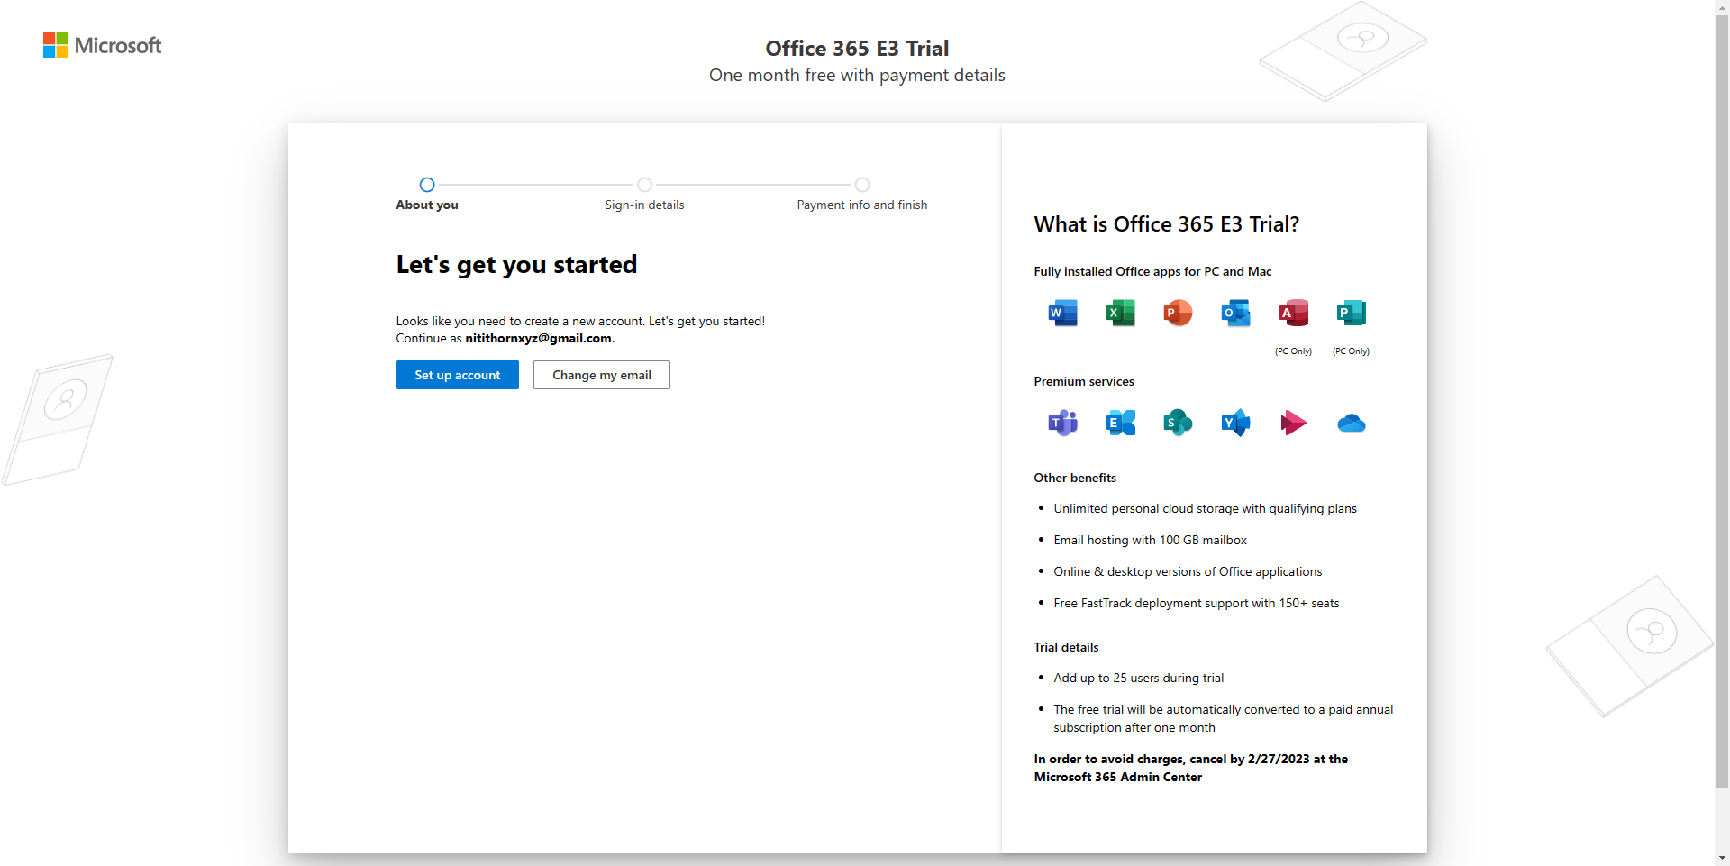
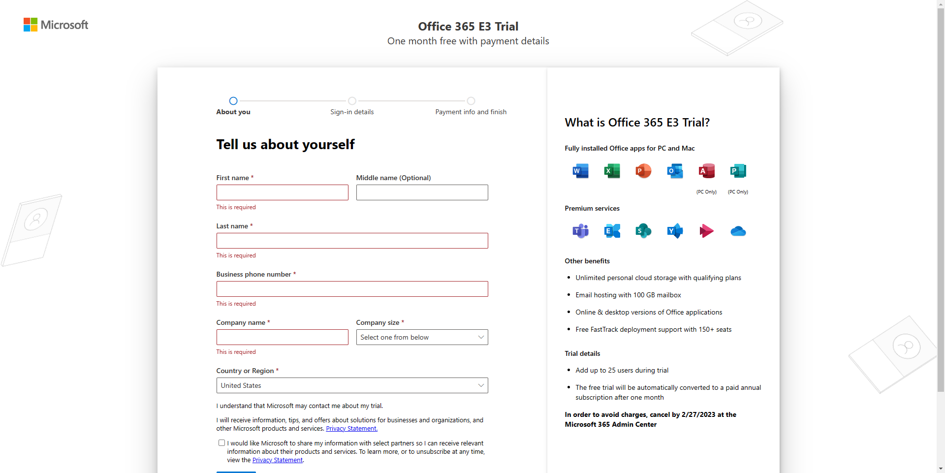

Slide 5
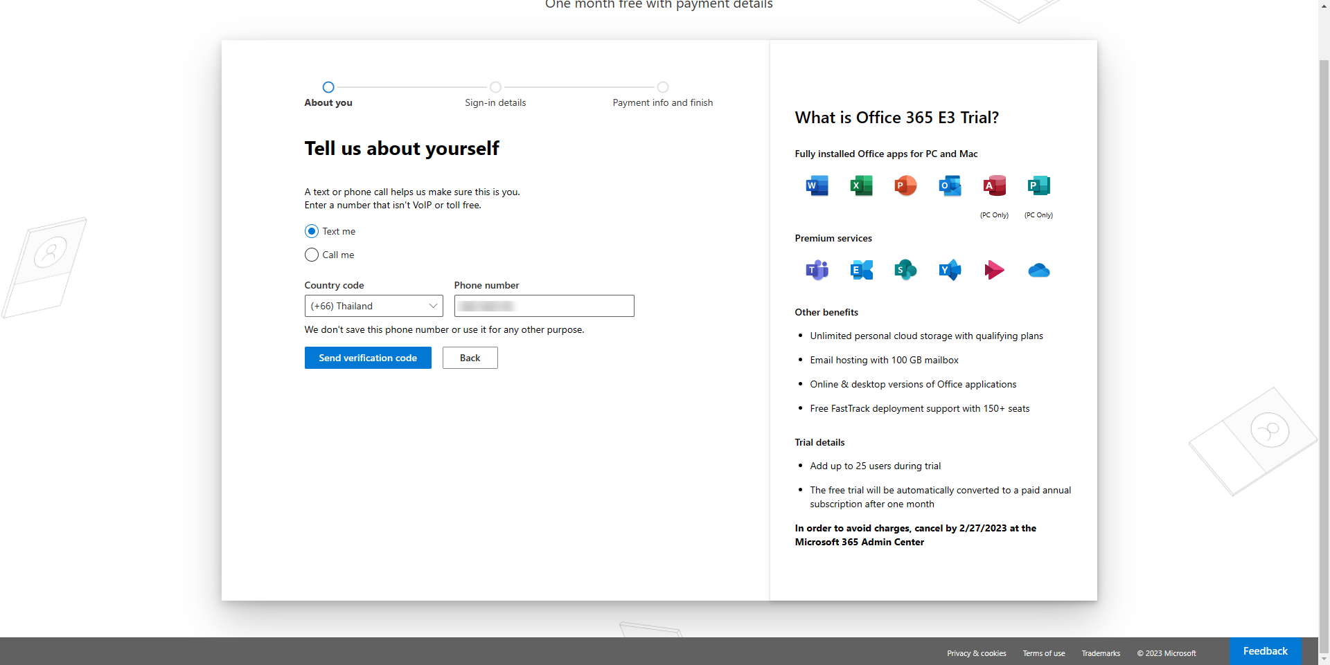
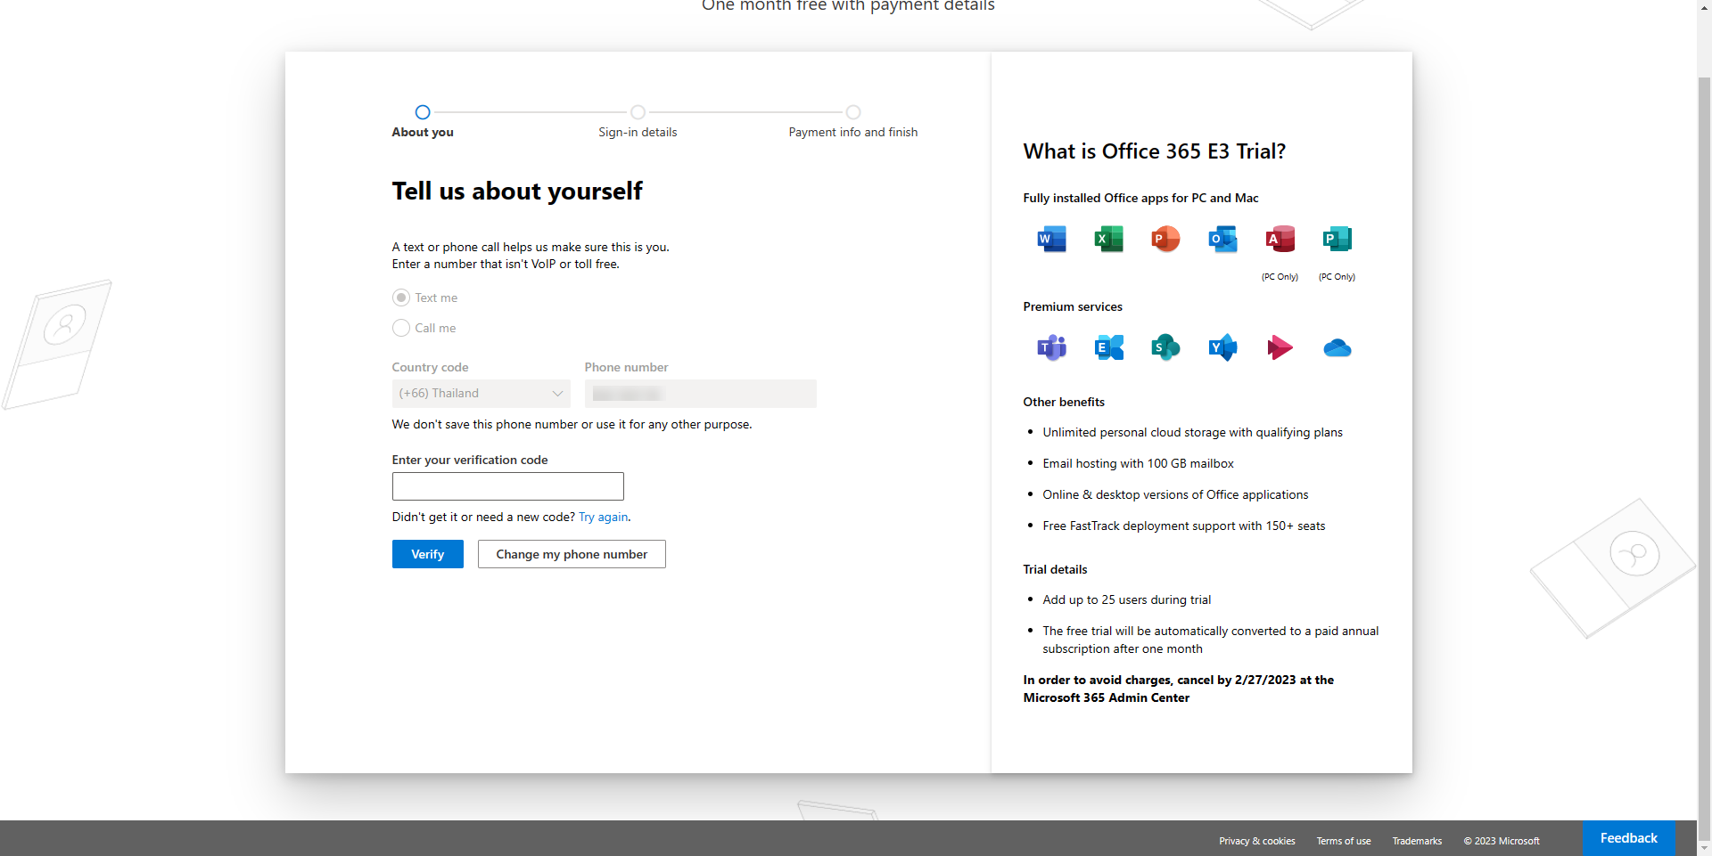

Slide 6
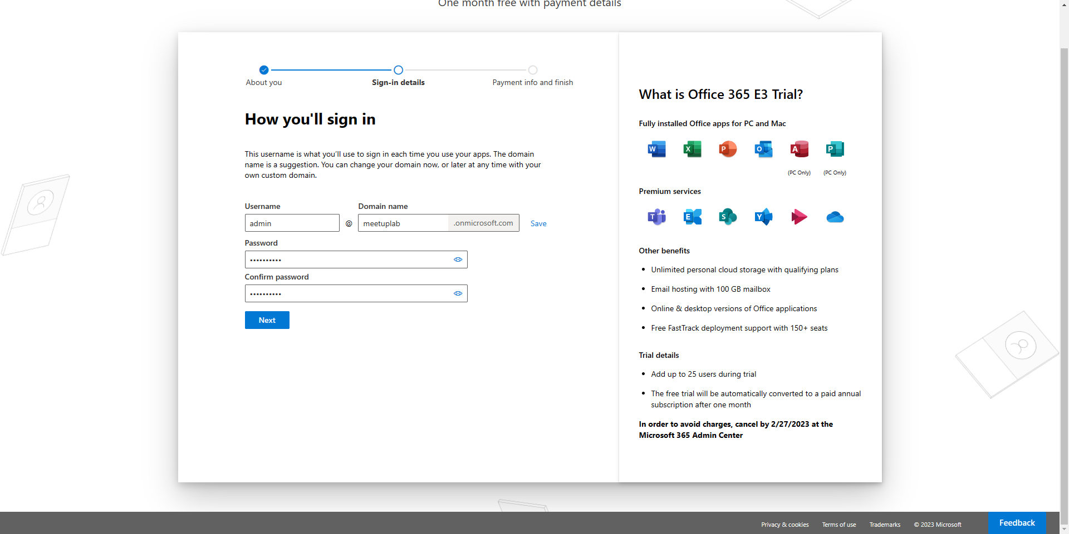
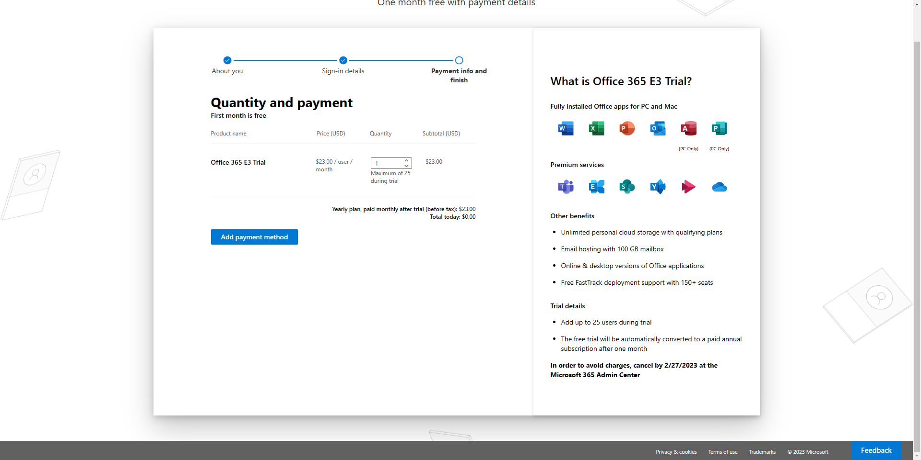

Slide 7
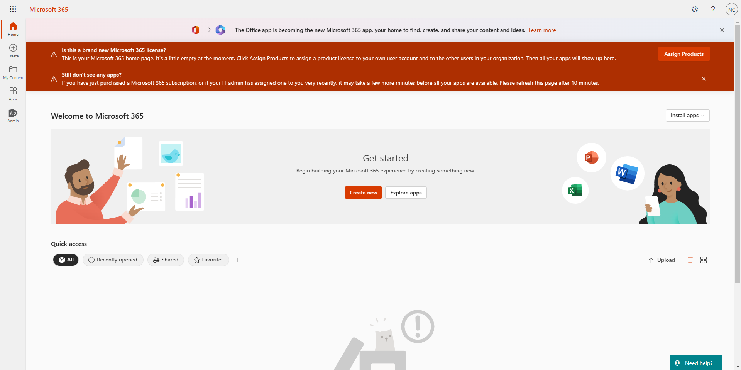
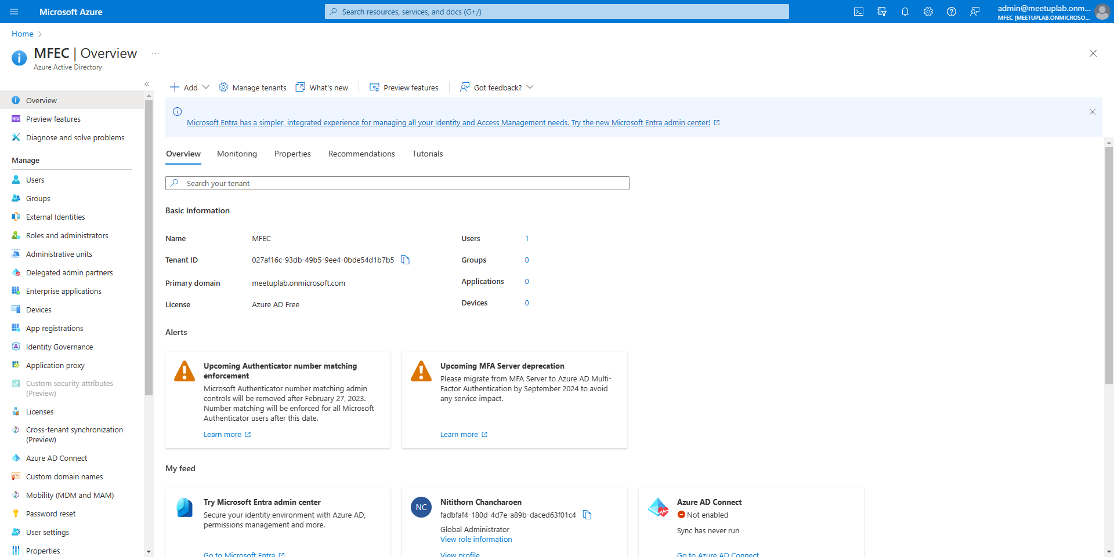

Slide 8
AzureAD Module

Slide 9
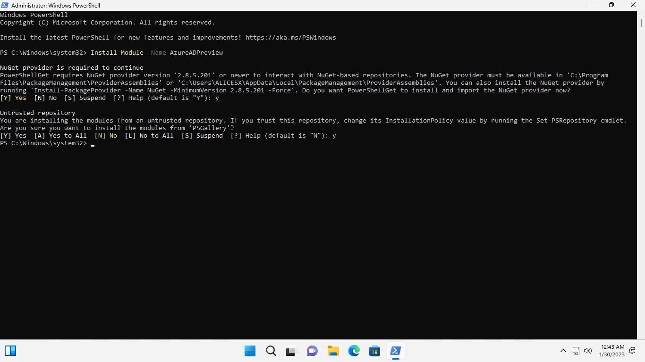
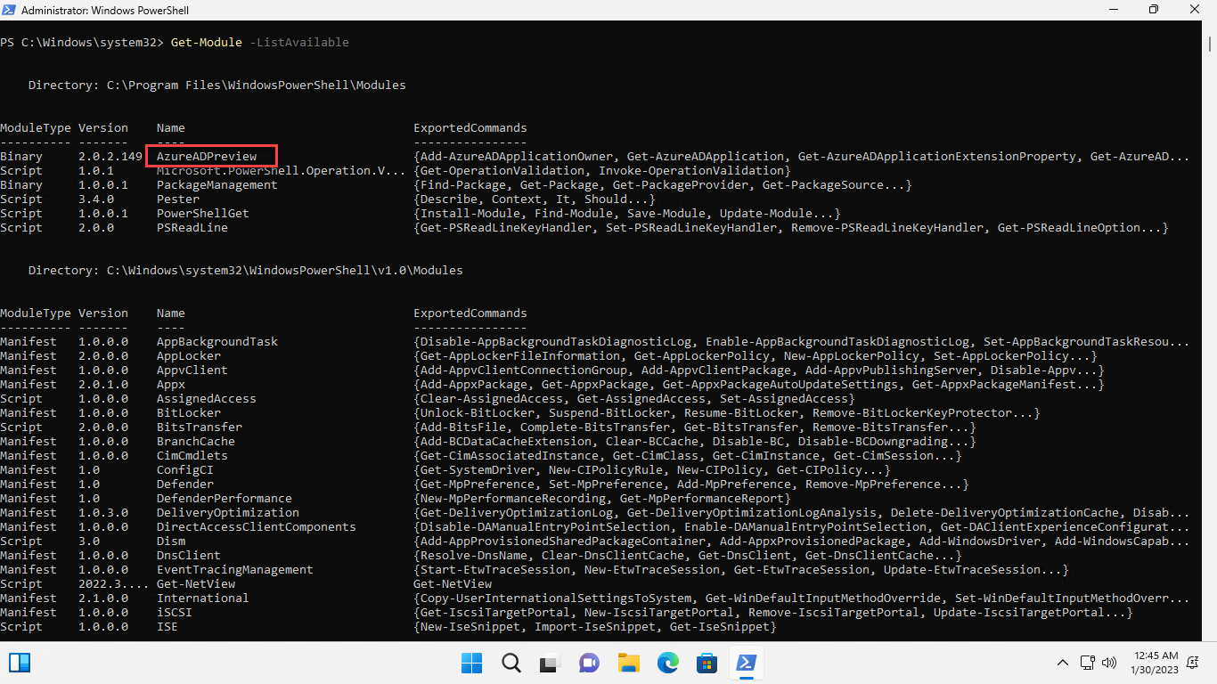
Install-Module -Name AzureADPreview

Slide 10
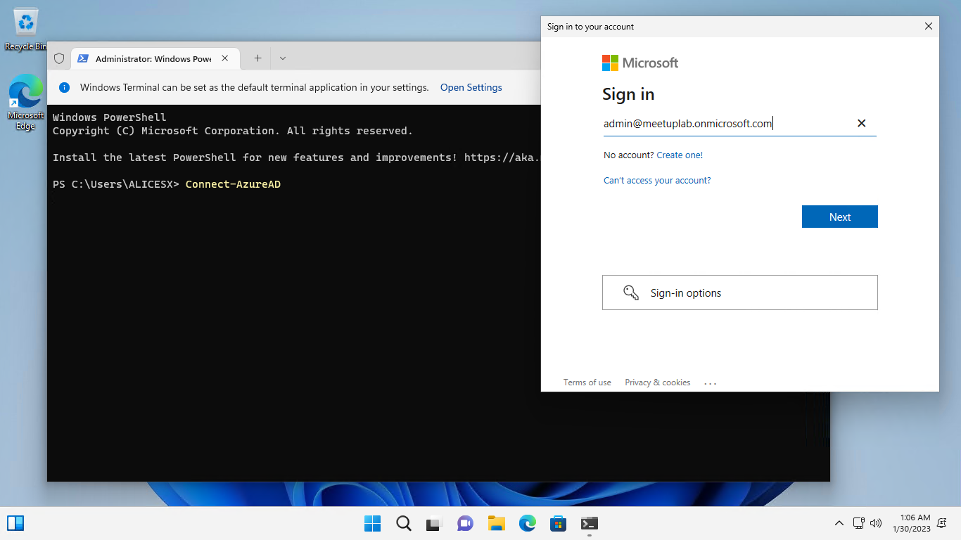
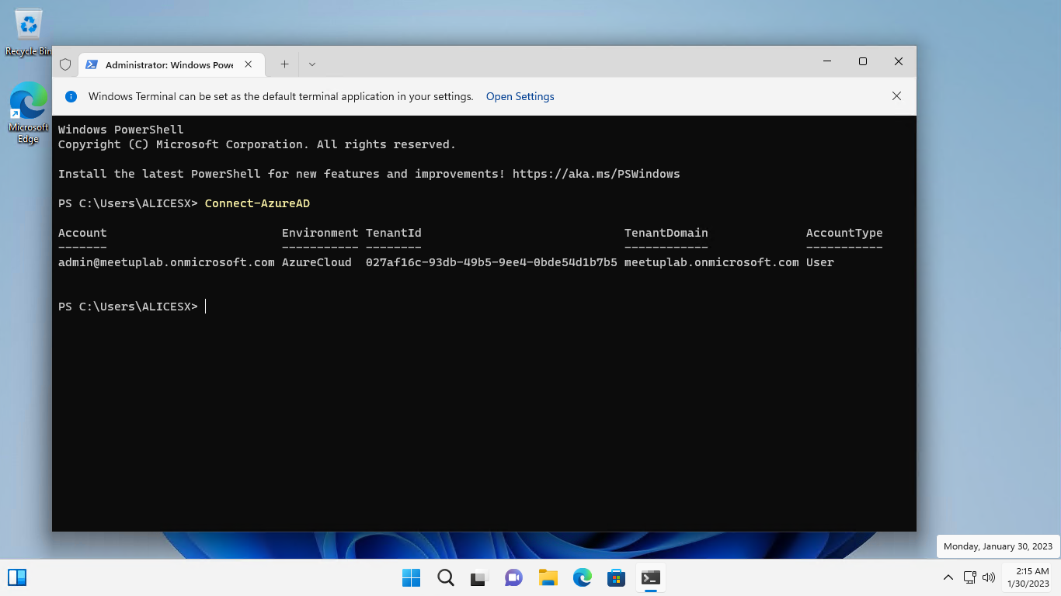
Connect-AzureAD

Slide 11
Azure AD Basic PowerShell

Slide 12
Download
Meetup

Slide 13
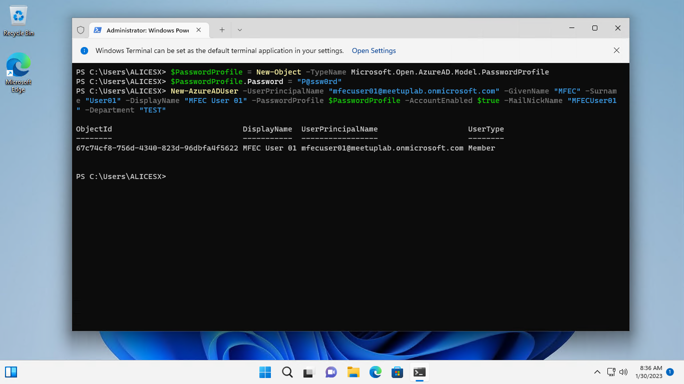
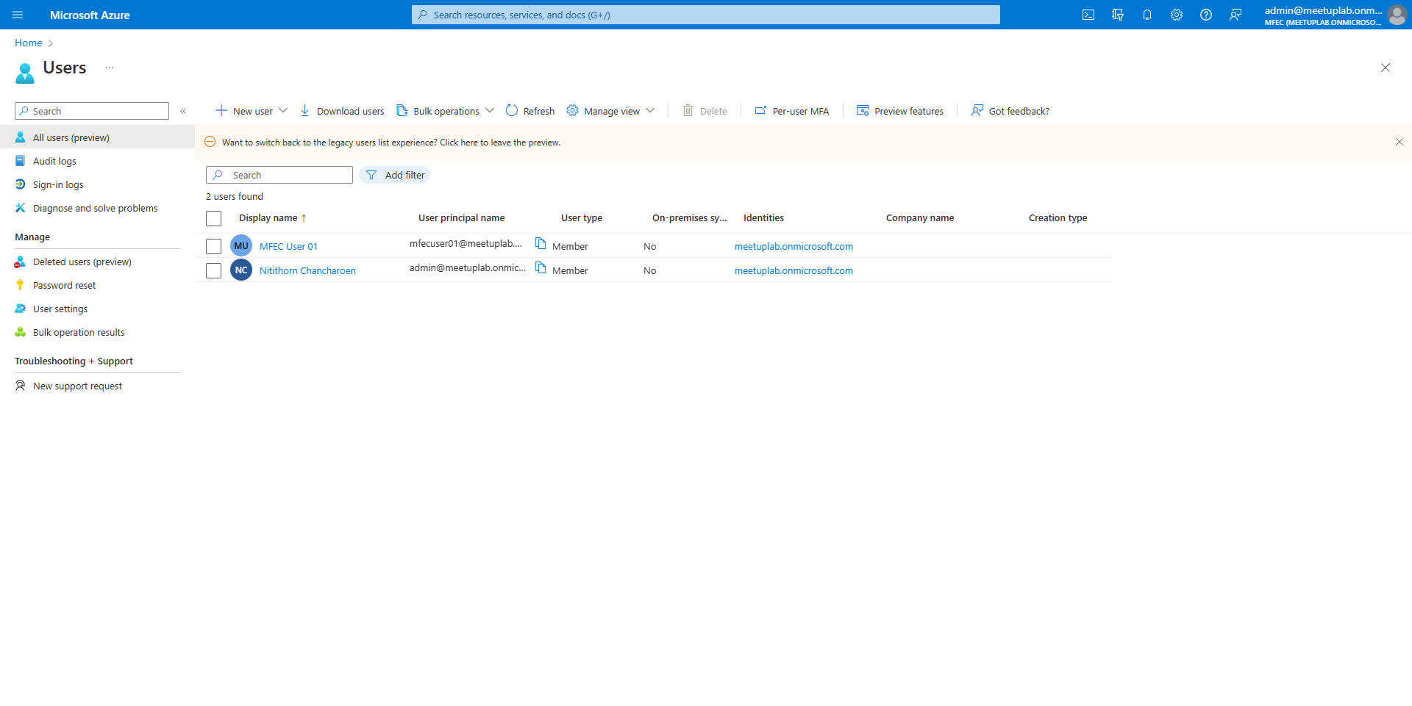
$PasswordProfile = New-Object -TypeName Microsoft.Open.AzureAD.Model.PasswordProfile
$PasswordProfile.Password = "P@ssw0rd"
New-AzureADUser -UserPrincipalName "mfecuser01@meetuplab.onmicrosoft.com" -GivenName "MFEC" -Surname "User01" -DisplayName "MFEC User 01" -PasswordProfile $PasswordProfile -AccountEnabled $true -MailNickName "MFECUser01" -Department "TEST"

Slide 14
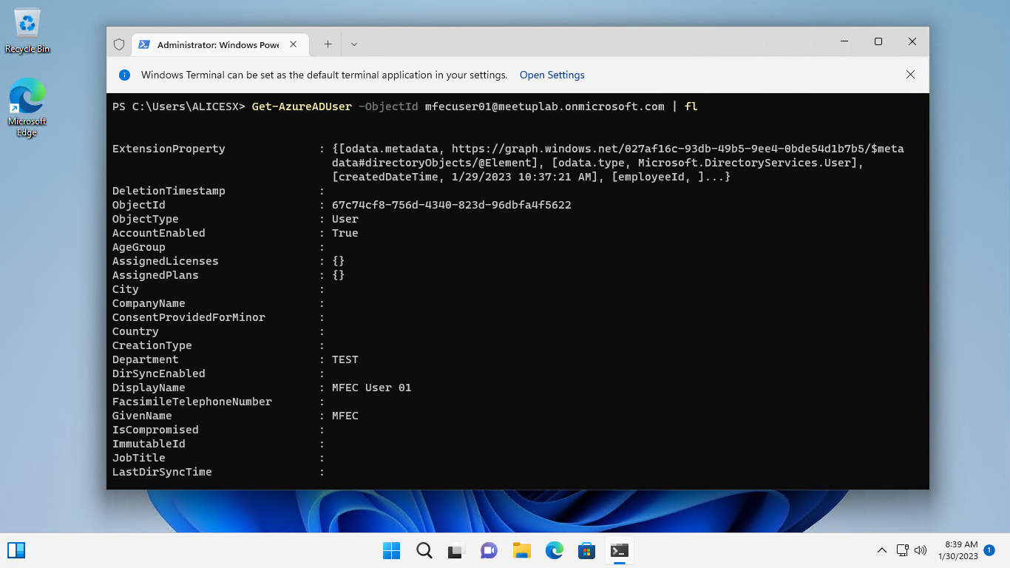
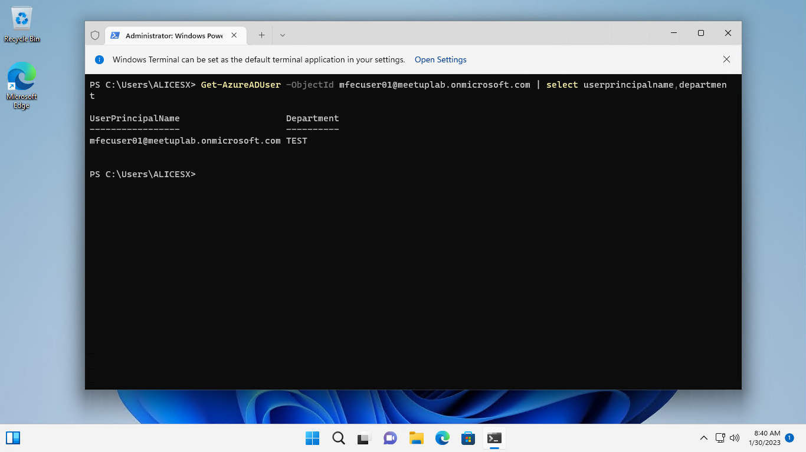
Get-AzureADUser -ObjectId mfecuser01@meetuplab.onmicrosoft.com | fl
Get-AzureADUser -ObjectId mfecuser01@meetuplab.onmicrosoft.com | select userprincipalname,department

Slide 15
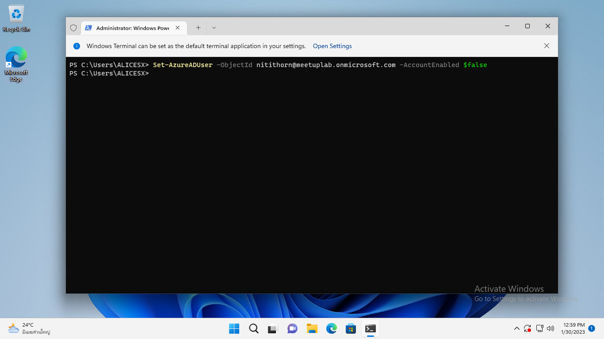
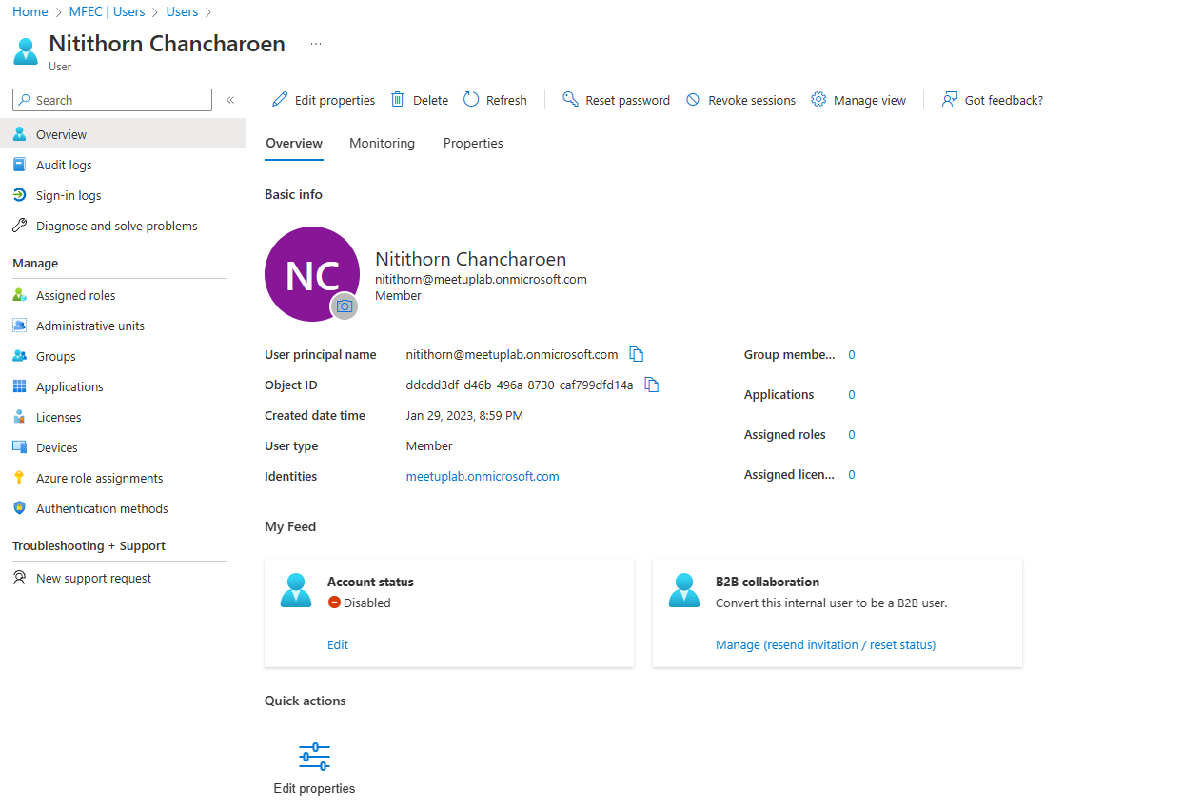
Set-AzureADUser -ObjectId nitithorn@meetuplab.onmicrosoft.com -AccountEnabled $false

Slide 16
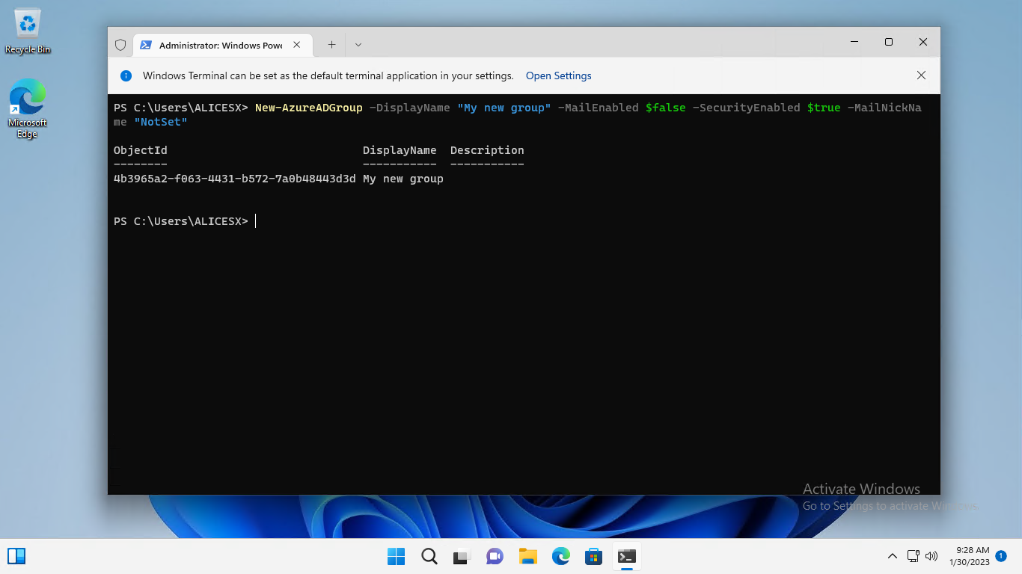
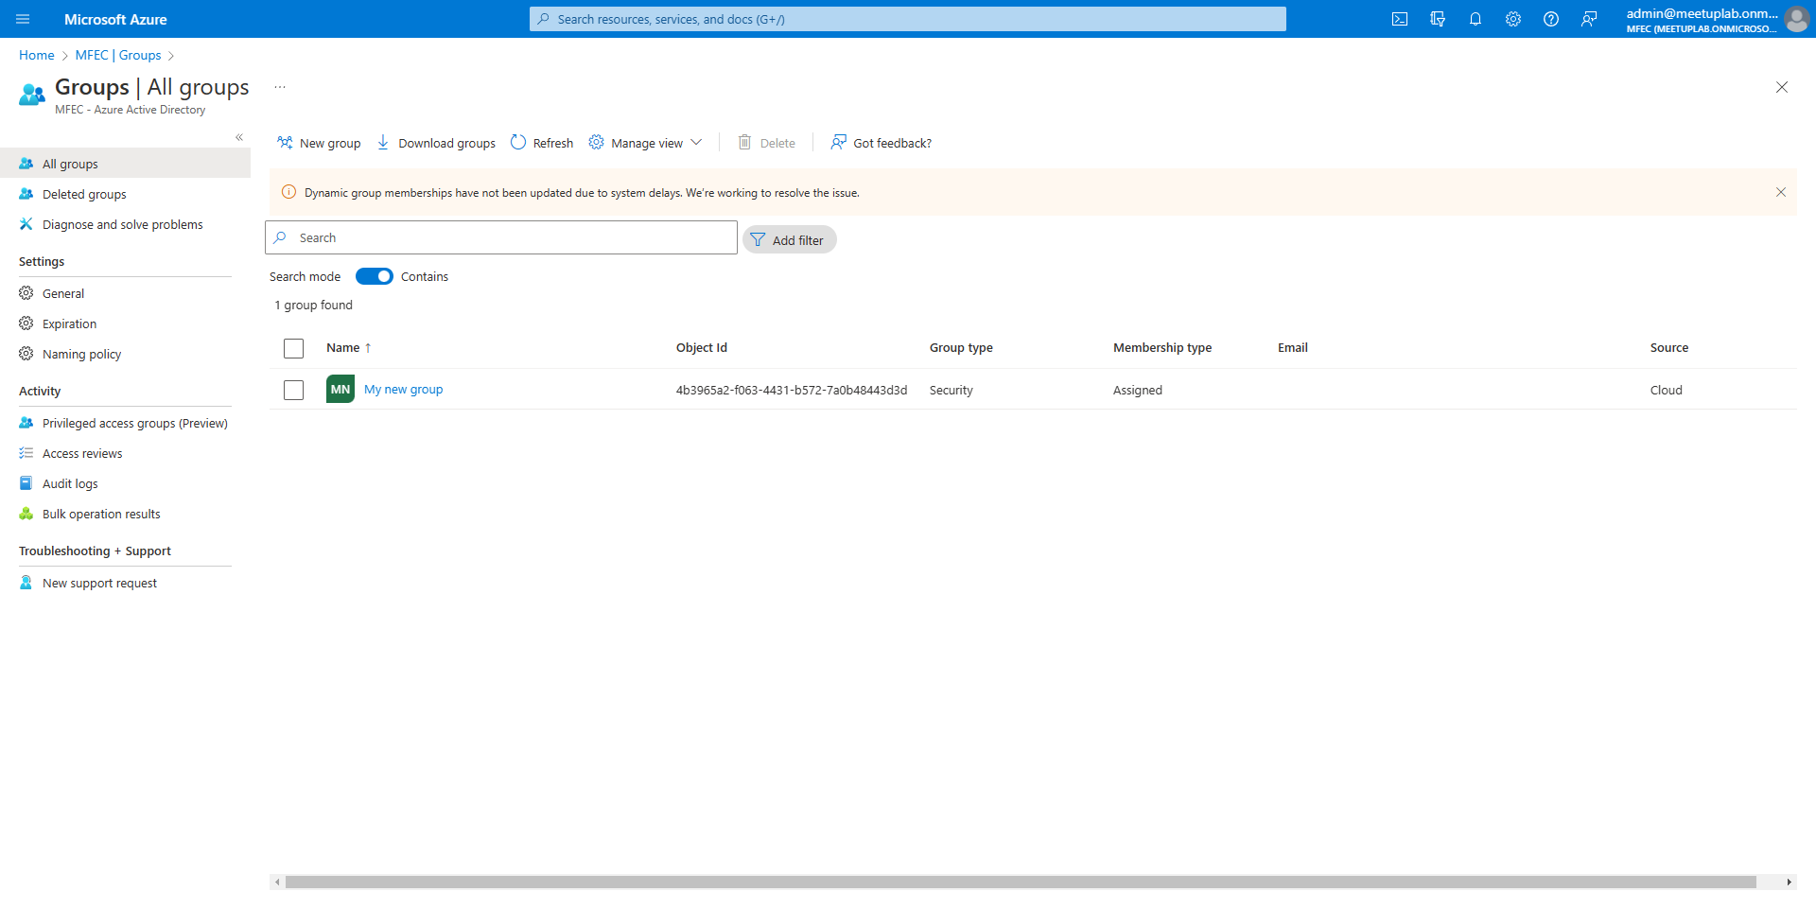
New-AzureADGroup -DisplayName "My new group" -MailEnabled $false -SecurityEnabled $true -MailNickName "NotSet"

Slide 17
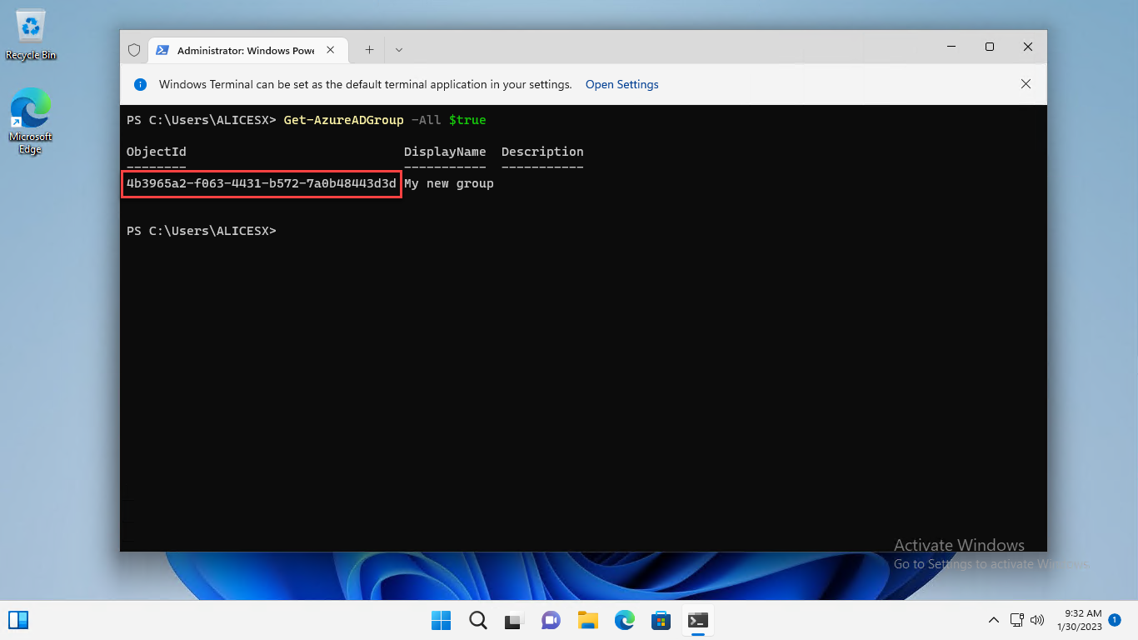
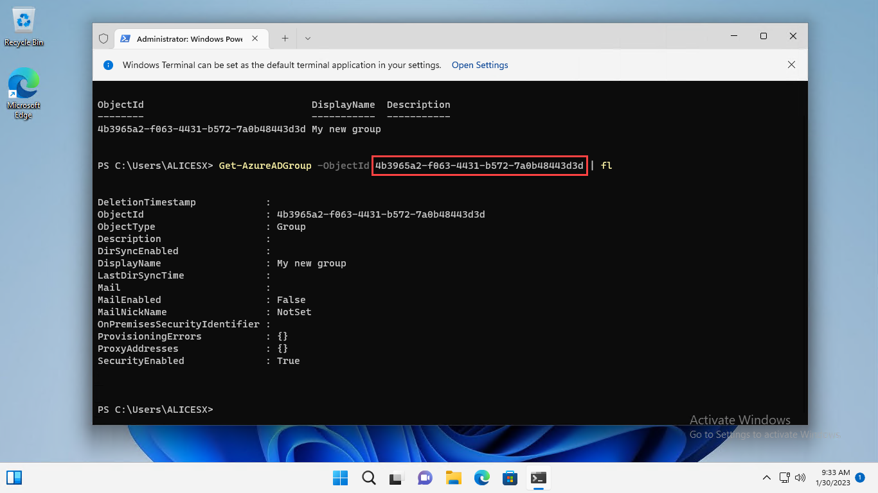
Get-AzureADGroup -All $true
Get-AzureADGroup -ObjectId 4b3965a2-f063-4431-b572-7a0b48443d3d

Slide 18
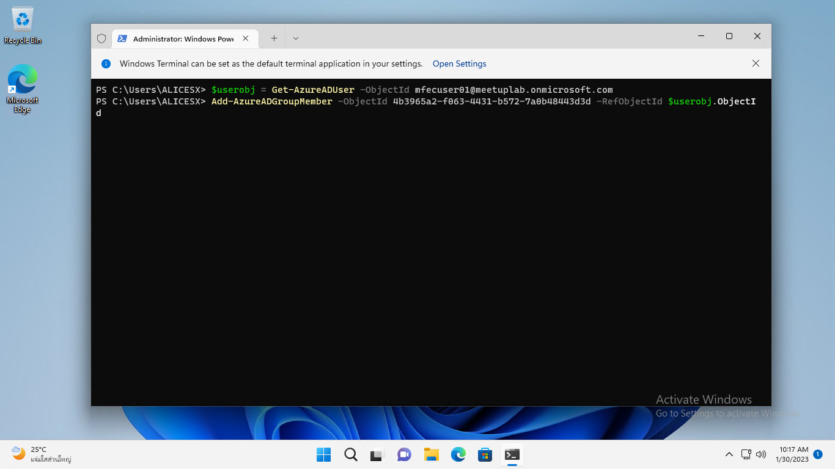
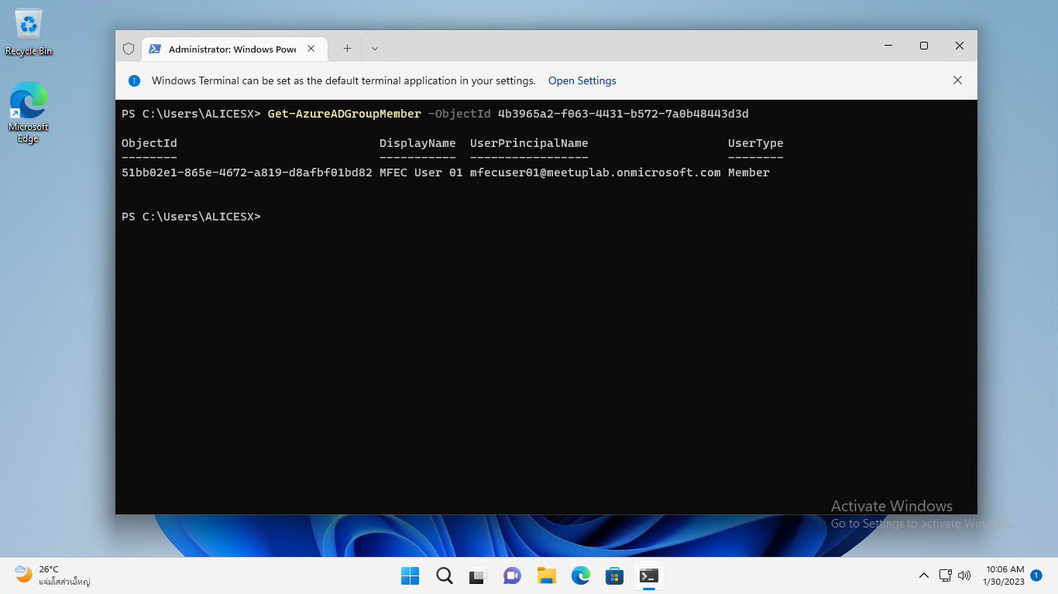
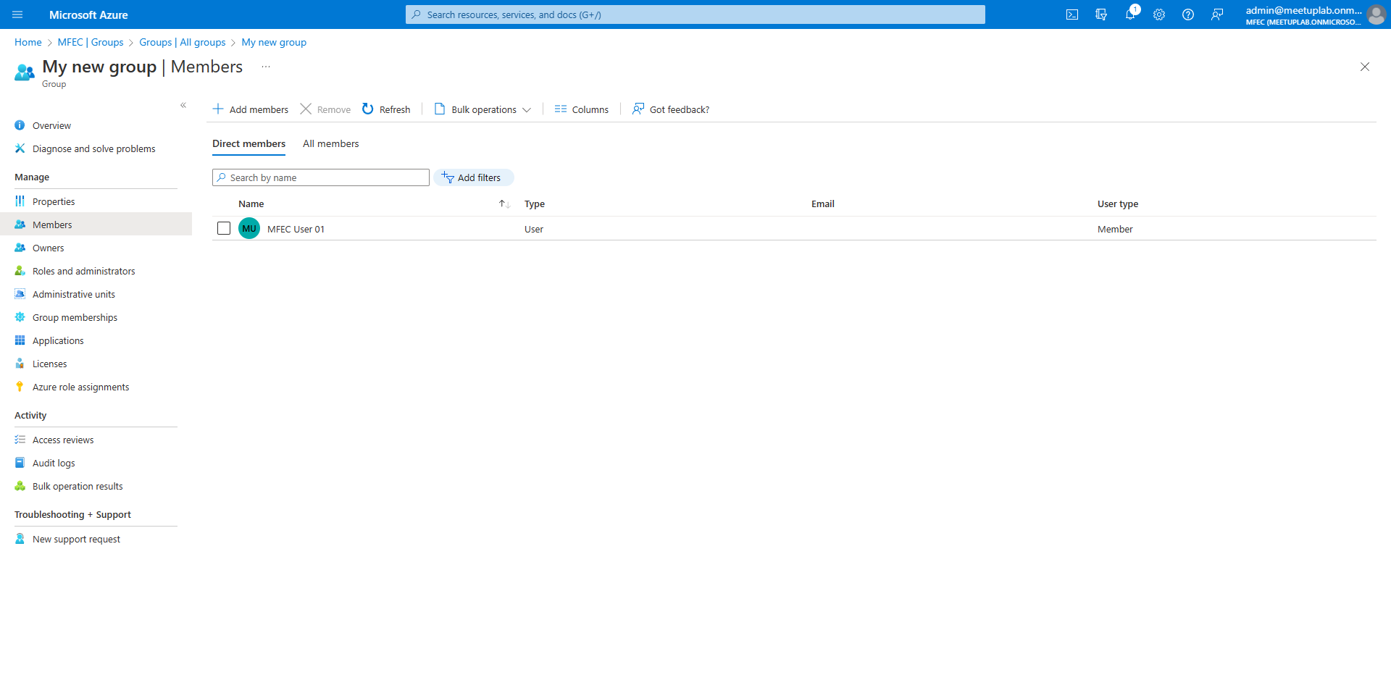
$userobj = Get-AzureADUser -ObjectId mfecuser01@meetuplab.onmicrosoft.com
Add-AzureADGroupMember -ObjectId 4b3965a2-f063-4431-b572-7a0b48443d3d -RefObjectId $userobj.ObjectId
Get-AzureADGroupMember -ObjectId 4b3965a2-f063-4431-b572-7a0b48443d3d

Slide 19
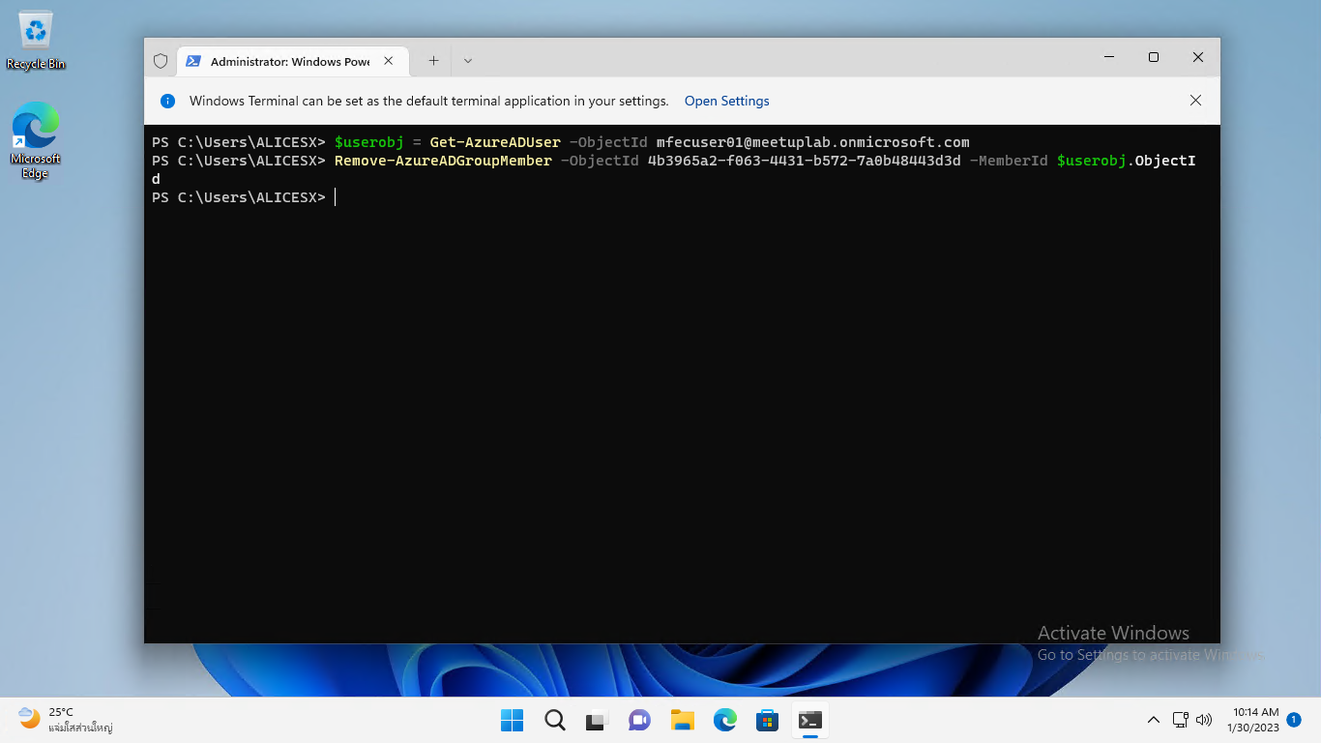
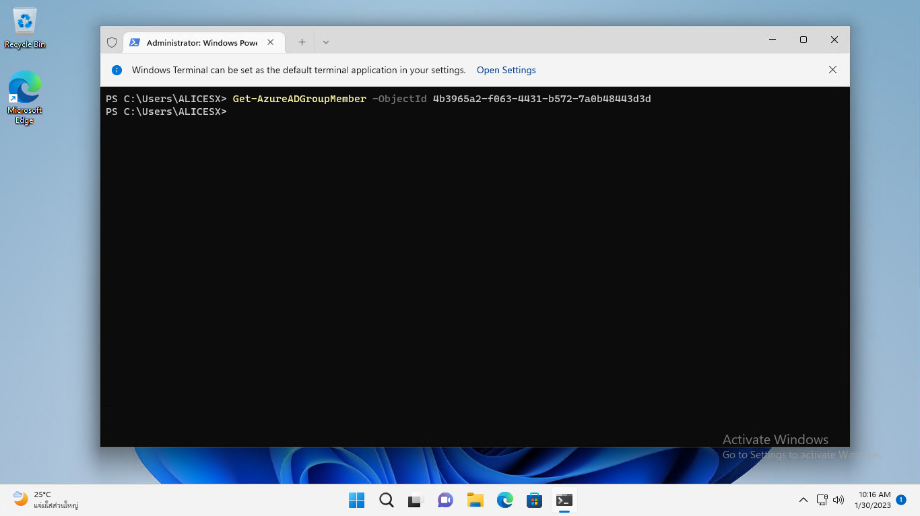
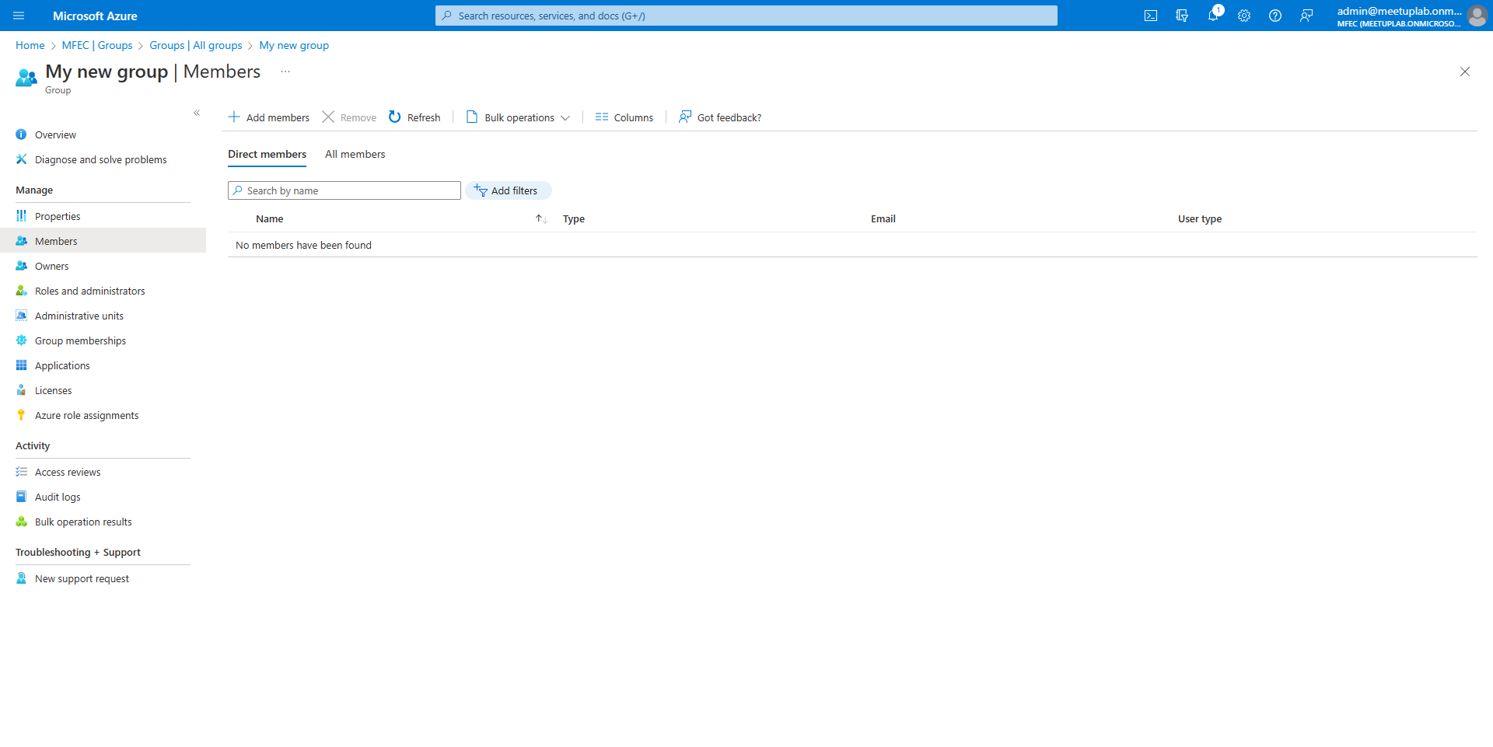
$userobj = Get-AzureADUser -ObjectId mfecuser01@meetuplab.onmicrosoft.com
Remove-AzureADGroupMember -ObjectId 4b3965a2-f063-4431-b572-7a0b48443d3d -MemberId $userobj.ObjectId
Get-AzureADGroupMember -ObjectId 4b3965a2-f063-4431-b572-7a0b48443d3d

Slide 20

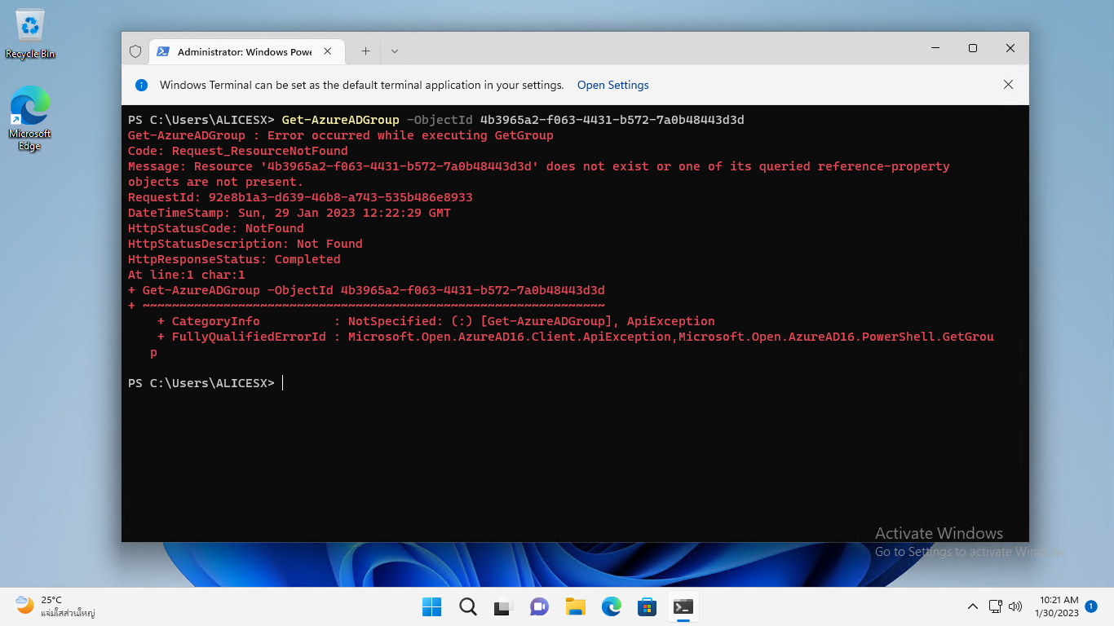
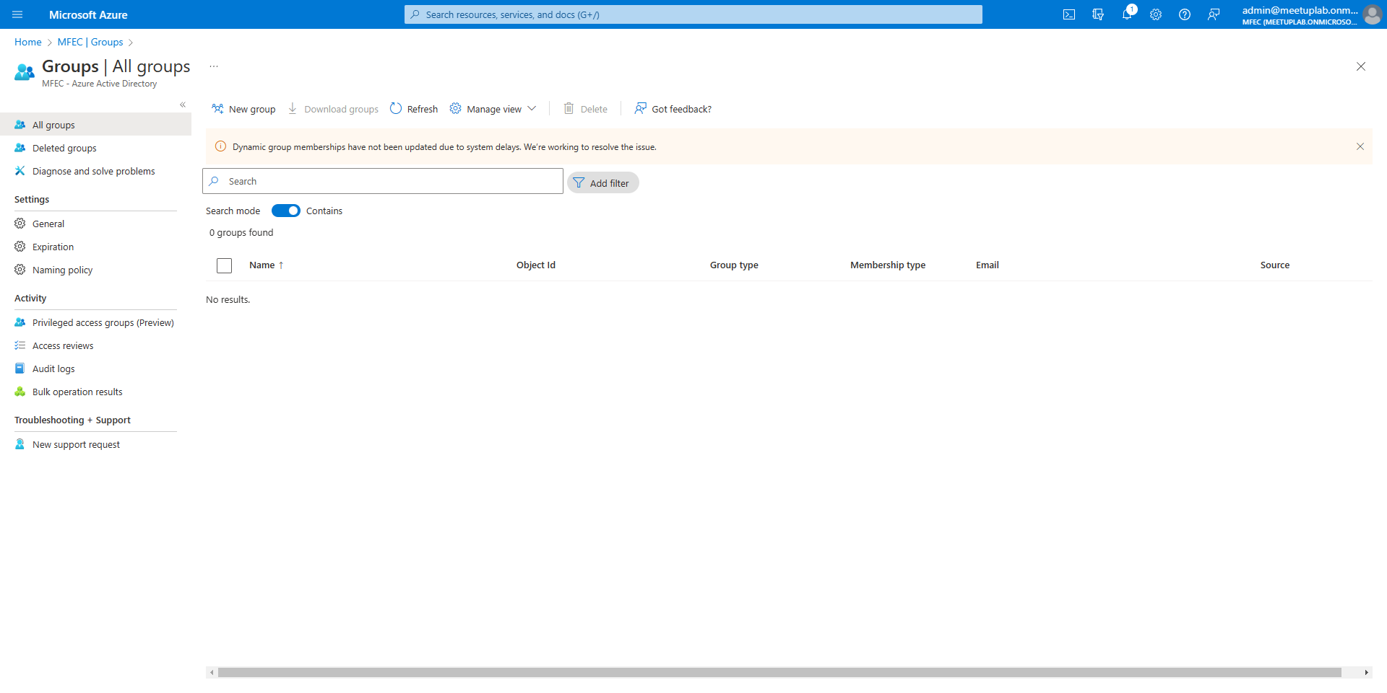
Remove-AzureADGroup -ObjectId 4b3965a2-f063-4431-b572-7a0b48443d3d

Slide 21
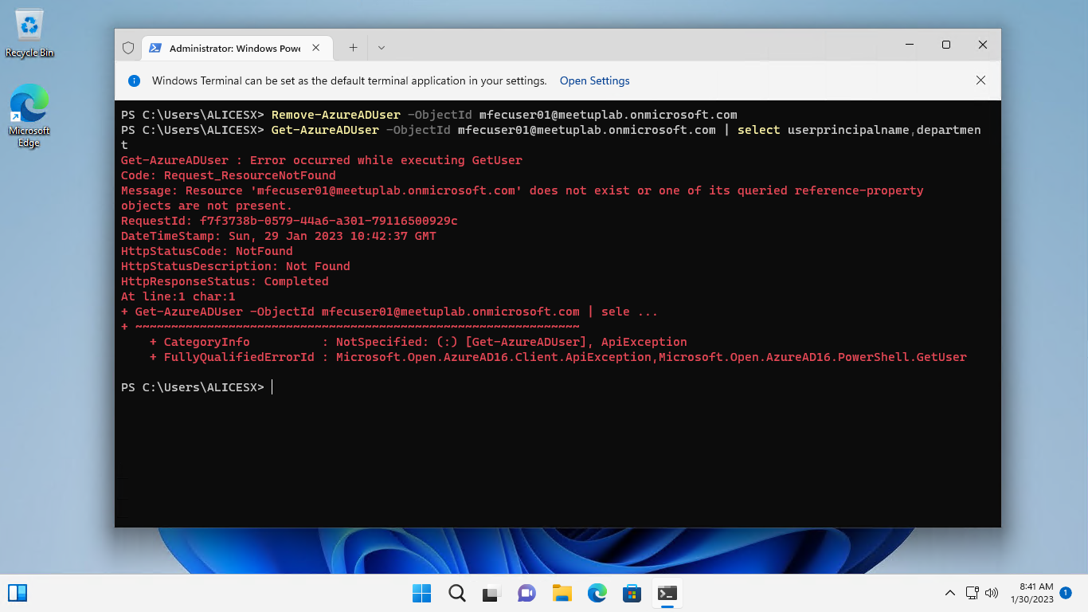
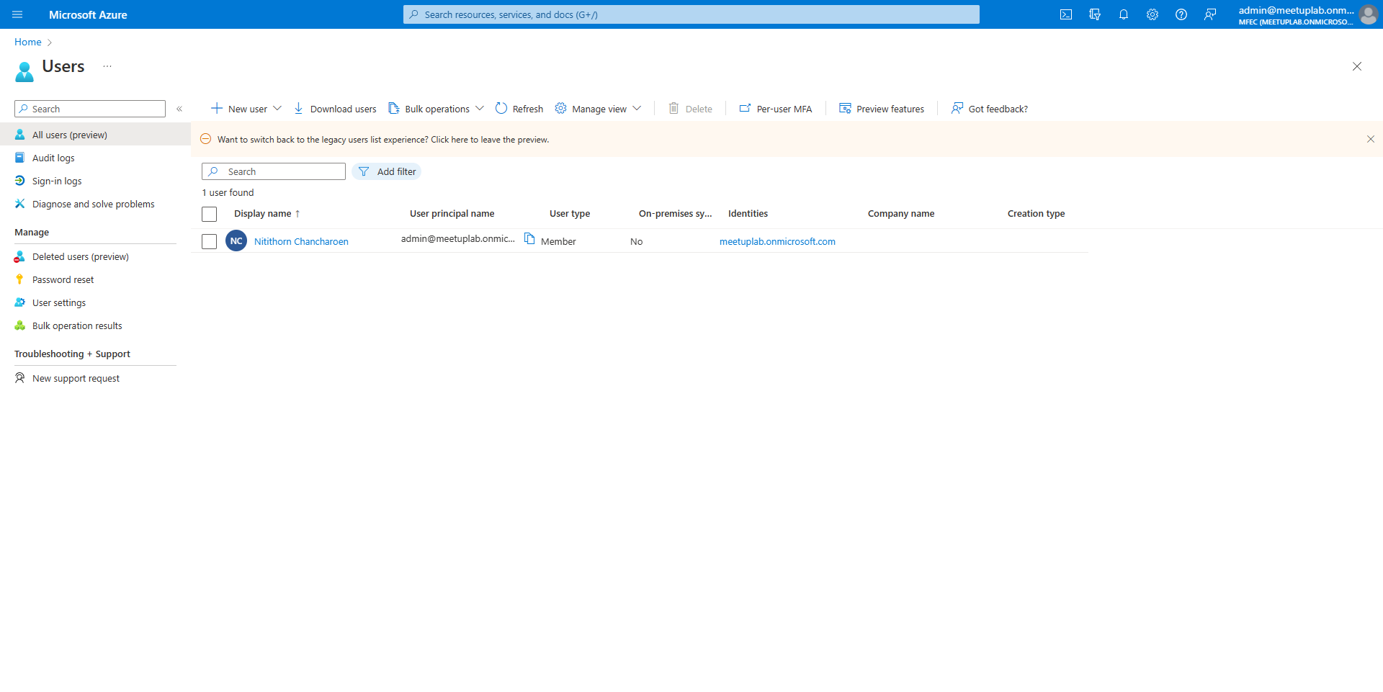
Remove-AzureADUser -ObjectId mfecuser01@meetuplab.onmicrosoft.com
Get-AzureADUser -ObjectId mfecuser01@meetuplab.onmicrosoft.com | select userprincipalname,department

Slide 22
IF/ELSE

Slide 23
if(Condition){
True
}else{
False
}

Slide 24
Operator PowerShell | Description | Operator
-eq | Compares two values to be equal or not. | ==
-ne | Compare the two values to be not equal. | !=
-gt | Compares the first value to be greater than the second one. | >
-ge | Compare the first value to be greater than or equals to the second one. | >=
-lt | Compare the first value to be less than the second one. | <
-le | Compares first value to be less than or equals to second one. | <=

Slide 25
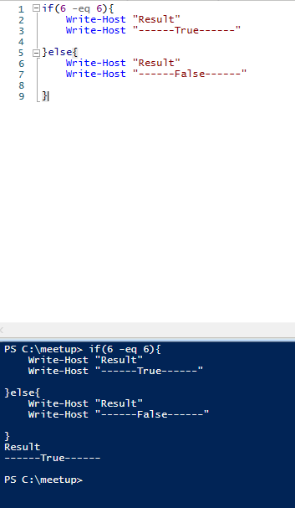
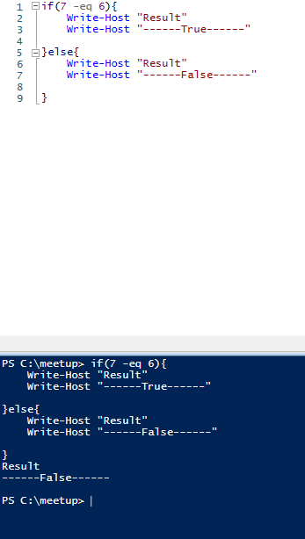
if(6 -eq 6){
Write-Host "Result"
Write-Host "------True------"
}else{
Write-Host "Result"
Write-Host "------False------"
}
if(7 -eq 6){
Write-Host "Result"
Write-Host "------True------"
}else{
Write-Host "Result"
Write-Host "------False------"
}

Slide 26
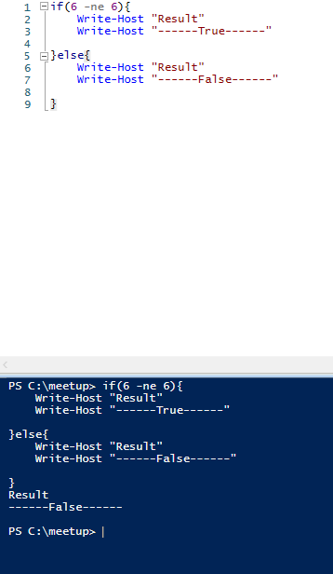
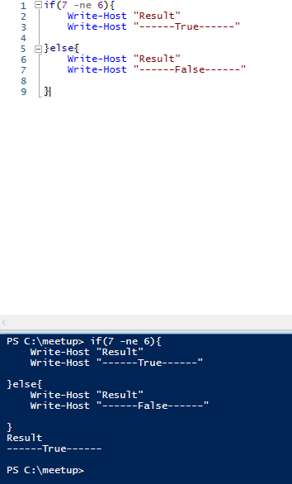
if(6 -ne 6){
Write-Host "Result"
Write-Host "------True------"
}else{
Write-Host "Result"
Write-Host "------False------"
}
if(7 -ne 6){
Write-Host "Result"
Write-Host "------True------"
}else{
Write-Host "Result"
Write-Host "------False------"
}

Slide 27
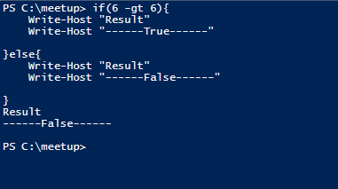
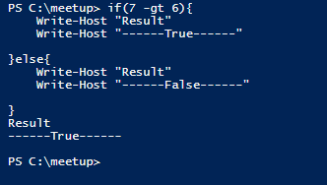
if(6 -gt 6){
Write-Host "Result"
Write-Host "------True------"
}else{
Write-Host "Result"
Write-Host "------False------"
}
if(7 -gt 6){
Write-Host "Result"
Write-Host "------True------"
}else{
Write-Host "Result"
Write-Host "------False------"
}

Slide 28
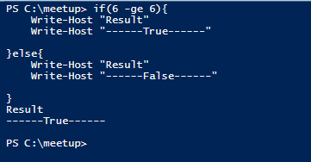
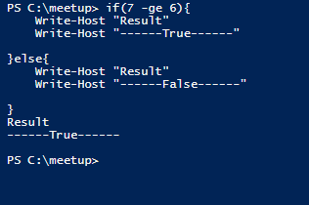
if(6 -ge 6){
Write-Host "Result"
Write-Host "------True------"
}else{
Write-Host "Result"
Write-Host "------False------"
}
if(7 -ge 6){
Write-Host "Result"
Write-Host "------True------"
}else{
Write-Host "Result"
Write-Host "------False------"
}

Slide 29
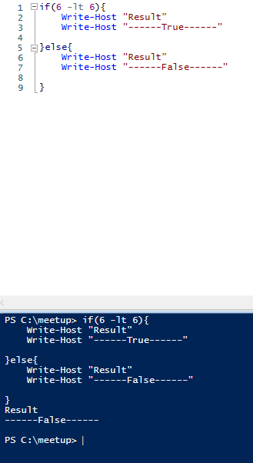
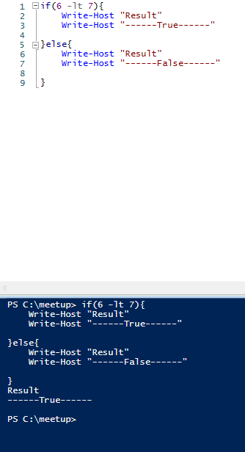
if(6 -lt 6){
Write-Host "Result"
Write-Host "------True------"
}else{
Write-Host "Result"
Write-Host "------False------"
}
if(6 -lt 7){
Write-Host "Result"
Write-Host "------True------"
}else{
Write-Host "Result"
Write-Host "------False------"
}

Slide 30
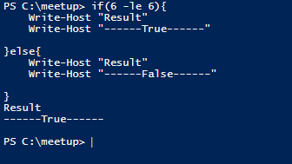
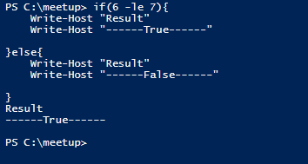
if(6 -le 6){
Write-Host "Result"
Write-Host "------True------"
}else{
Write-Host "Result"
Write-Host "------False------"
}
if(6 -le 7){
Write-Host "Result"
Write-Host "------True------"
}else{
Write-Host "Result"
Write-Host "------False------"
}

Slide 31
IF/ELSE Example

Slide 32
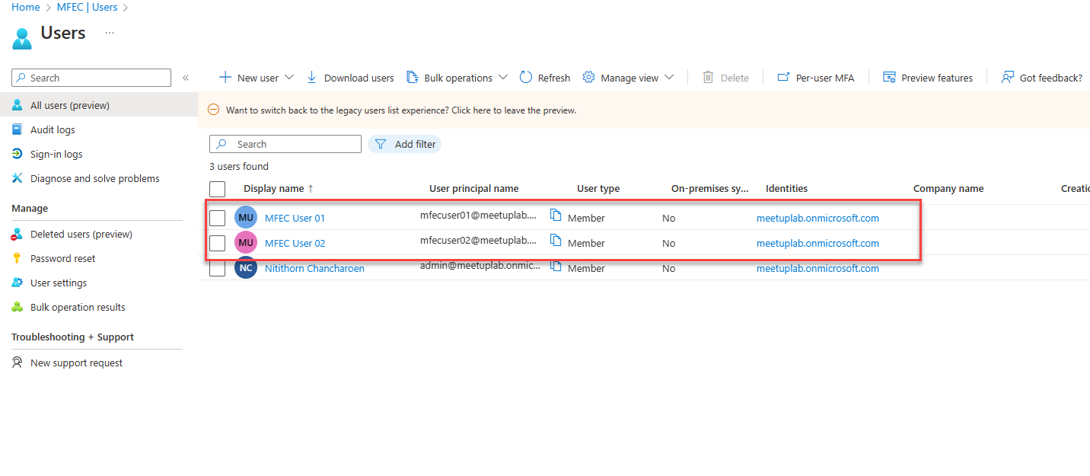
New-AzureADUser -UserPrincipalName "mfecuser01@meetuplab.onmicrosoft.com" -GivenName "MFEC" -Surname "User01" -DisplayName "MFEC User 01" -PasswordProfile $PasswordProfile -AccountEnabled $true -MailNickName "MFECUser01" -Department "TEST"
New-AzureADUser -UserPrincipalName "mfecuser02@meetuplab.onmicrosoft.com" -GivenName "MFEC" -Surname "User02" -DisplayName "MFEC User 02" -PasswordProfile $PasswordProfile -AccountEnabled $true -MailNickName "MFECUser02" -Department "No TEST"

Slide 33
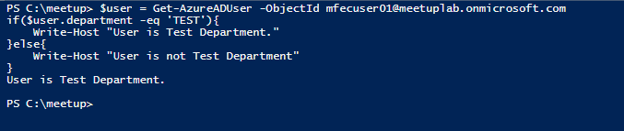
$user = Get-AzureADUser -ObjectId mfecuser02@meetuplab.onmicrosoft.com
if($user.department -eq 'TEST'){
Write-Host "User is Test Department."
}else{
Write-Host "User is not Test Department"
}

Slide 34
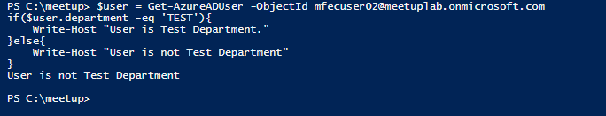
$user = Get-AzureADUser -ObjectId mfecuser02@meetuplab.onmicrosoft.com
if($user.department -eq 'TEST'){
Write-Host "User is Test Department."
}else{
Write-Host "User is not Test Department"
}

Slide 35
Import CSV files

Slide 36
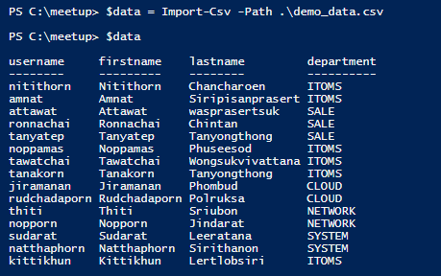
$data = Import-Csv -Path .\demo_data.csv
$data

Slide 37




$data.username
$data.firstname
$data.lastname
$data.department

Slide 38
FOREACH

Slide 39
$datas = ("First","Second","Third") foreach($temp in $datas){
use $temp for operation
}

Slide 40

$values = ("First","Second","Third")
foreach($value in $values){
Write-Host "Value is: "$value
}

Slide 41
FOREACH & CSV files

Slide 42

$values = Import-Csv .\demo_data.csv
foreach($value in $values){
Write-Host "Value is: "$value.username
}

Slide 43
Showcase

Slide 44
Scenario 1
ต้องการ Create User พร้อมกันจำนวนมากในครั้งเดียว โดยที่หาก User ที่ต้องการ Create มีอยู่แล้วบน Tenant ให้มีการแจ้งเตือนว่า User นั้นมีอยู่แล้ว

Slide 45
$users = Import-Csv -Path.\demo_data.csv
$domain = Get-AzureADDomain | select name
$PasswordProfile = New-Object -TypeName Microsoft.Open.AzureAD.Model.PasswordProfile
$PasswordProfile.Password = "P@ssw0rd"
foreach($user in $users){
$username = $user.username + "@" + $domain.name
$exuser = Get-AzureADUser -Filter "UserPrincipalName eq '$username'"
$displayname = $user.firstname+" "+$user.lastname
if($username -ne $exuser.UserPrincipalName){
New-AzureADUser -UserPrincipalName $username -GivenName $user.firstname -Surname $user.lastname -DisplayName $displayname -PasswordProfile $PasswordProfile -AccountEnabled $true -MailNickName $user.username -Department $user.department
}else{
Write-Host "User: " $username "already In your Tenant"
}
}

Slide 46
Scenario 2
ต้องการ List User ที่อยู่ Department ITOMS ทั้งหมดบน Tenant

Slide 47

$allusers = Get-AzureADUser -All $true
foreach($alluser in $allusers){
if($alluser.department -eq 'ITOMS'){
Write-Host "User: " $alluser.UserPrincipalName " Is ITOMS Teams"
}
}

Slide 48
Quiz
ต้องการ List User ที่อยู่ Department SALE ทั้งหมดบน Tenant

Slide 49
Scenario 3
ต้องการ Disable User ทิ่อยู่ Department ITOMS ทั้งหมดบน Tenant

Slide 50
$allusers = Get-AzureADUser -All $true
foreach($alluser in $allusers){
if($alluser.department -eq 'ITOMS'){
Set-AzureADUser -ObjectId $alluser.ObjectId -AccountEnabled $false
}
}

Slide 51
Quiz
ต้องการ Disable User ทิ่อยู่ Department Network ทั้งหมดบน Tenant

Slide 52
Scenario 4
Create Group ตาม Department และ Add คนที่อยู่ใน Department นั้นๆ เข้า Group ที่ Create ขึ้นมา โดยใช้ข้อมูลจาก CSV file

Slide 53
$datas = Import-Csv -Path .\demo_data.csv
foreach($data in $datas){
$department = $data.department
$exgroup = Get-AzureADGroup -Filter "DisplayName eq '$department'"
if($data.department -ne $exgroup.Displayname){
New-AzureADGroup -DisplayName $data.department -MailEnabled $false -SecurityEnabled $true -MailNickName "NotSet"
}
}
$domain = Get-AzureADDomain | select name
foreach($data in $datas){
$department = $data.department
$exgroup = Get-AzureADGroup -Filter "DisplayName eq '$department'"
$username = $data.username + "@" + $domain.name
$user = Get-AzureADUser -ObjectId $username
if($data.department -eq $exgroup.DisplayName){
Remove-AzureADGroupMember -ObjectId $exgroup.ObjectId -RefObjectId $user.ObjectId
}
}

Slide 54
Quiz
Remove User ออกจาก Group ที่ตนเองอยู่ทั้งหมด ตามข้อมูลใน CSV file

Slide 55
Quiz
ต้องการ Delete User ตาม List ใน CSV file

